Slide 1
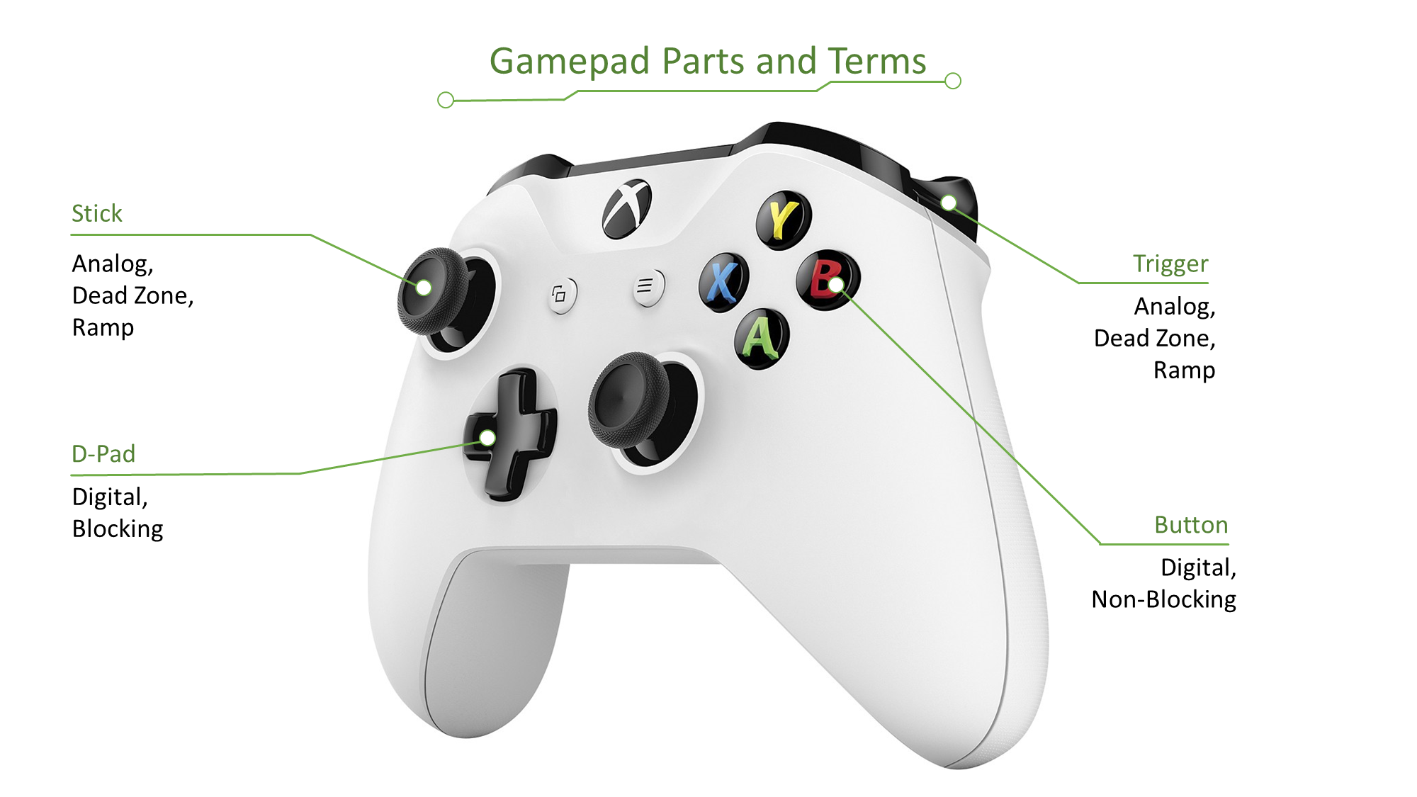
Created for Intro to Game Programming at the University of Nebraska at Omaha
But free for anyone to use and learn.
B. Ricks, PhD

Slide 2
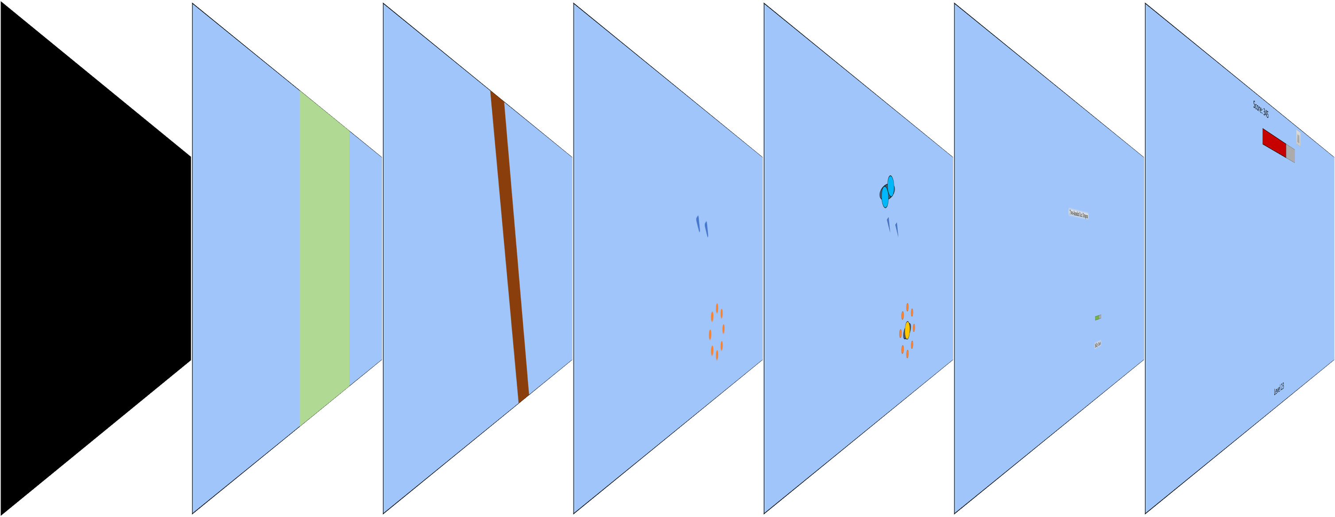
Visual Layers
Clear Screen
Background
World
Background
World
Midground
Effects
Layer
World
Foreground
World/UI
Transition
UI

Slide 3
Forest of Scene Trees
Often Called the Scene Graph
Title Scene
Loading Scene
Main Scene
…
Game Object
Game Object
Game Object
Game Object
Game Object
Game Object
Game Object
Game Object
Game Object
Game Object
Game Object
Game Object
Game Object
Game Object

Slide 4



Composition v. Inheritance
INHERITANCE PROBLEM
We can’t arrange subclasses in a way that is not redundant.
Inheritance Option 1
Inheritance Option 2
Game Object
Player Controlled
Snowman Geo
Game Object
Snowman Geo
Player Controlled
“Frosty”,
Snowman Geo +
Player Controlled
“Rudolph”,
Deer Geo +
AI Controlled
v.
Game Object
AI Controlled
Deer Geo
Game Object
Deer Geo
AI Controlled
“Evil Snowman”,
Snowman Geo +
AI Controlled
Game Object
AI Controlled
Snowman Geo
Game Object
Snowman Geo
AI Controlled
Icons courtesy FontAwesome Pro Account.

Slide 5
Object Composition
TWO KINDS OF COMPONENTS
Components are either engine-defined or game-defined.
Object Composition
Game Object
Components
Snowman Geo
Player Controlled
Engine-Defined Components
“Frosty”,
Snowman Geo +
Player Controlled
“Rudolph”,
Deer Geo +
AI Controlled
Most drawing components are defined in the game engine.
v.
Game Object
Components
Deer Geo
AI Controlled
Game Object
Components
Snowman Geo
AI Controlled
Game-Defined Components
“Evil Snowman”,
Snowman Geo +
AI Controlled
Most behavior components are defined in the game.
Icons courtesy FontAwesome Pro Account.

Slide 6







Scene Graph Names
Engine | Scene | Game Object
Unity | Scene | GameObject
Unreal | Level | Pawn
CRYENGINE/Lumber Yard | Level | Entity
Phaser | Scene | GameObject
Godot | Stage | Node
Game Maker | Room | Instance
Ogre | Scene | Entity

Slide 7

Gamepad Parts and Terms
Stick
Analog,
Dead Zone,
Ramp
Trigger
Analog,
Dead Zone,
Ramp
D-Pad
Digital,
Blocking
Button
Digital,
Non-Blocking

Slide 8

Keyboards in Javascript
KeyboardEvent.key
onKey[Down/Up](event)
Example Values
event.key
KeyboardEvent.key
event.ctrlKey
boolean
event.shiftKey
boolean
event.altKey
boolean
event.metaKey
boolean
“q” or “Q”
“Enter”
“Shift”
“ ”
“ArrowDown”

Slide 9

Mice in Javascript
onMouse[Move/*](event)
Mice Button/Wheel Codes
event.screen[X/Y]
Double
event.client[X/Y]
Double
event.offset[X/Y]
Double
event.[ctrl/alt/shift]Key
Boolean
2 (Right)
0 (Left)
1 (Middle Click)
deltaY
onMouse[Down/Up](event)
Up
Negative Value
Down
Positive Value
event.key
Button Code
onMouseWheel(event)
event.deltaY
Double

Slide 10
Events vs. Polling
Events
Polling
Best for discrete input
Called outside of game loop
Called by event system
Best for continuous input
Called inside of game loop
Called by user code
Game Engine
Stored Input State
Event Listener
Update
Method
Similar event vs. polling choices

Slide 11
Events vs. Polling
Events
Best for discrete input
Called outside of game loop
Called by event system
Game Engine
Event Listener
Polling
Best for continuous input
Called inside of game loop
Called by user code
Stored Input State
Update
Method
Similar Event vs. Polling Choices
UI Components – Collisions – Physics

Slide 12
Collision Difficulty Spectrum
Easier
Harder
Points
Circles
Axis-Aligned Rectangles
Triangles
Convex Shapes
Concave Shapes
Can I approximate a harder collision with an easier one?
Precision Considerations
Physics Considerations
Do I need the location of the collision?
Do I need the sub-frame time or location of the collision?
Will momentum or angular momentum be transferred?
Can objects completely travel through each other in a frame?

Slide 13
Convex v. Concave
Convex Shapes
Concave Shapes
You cannot draw a line between a pair of points in the shape that leaves the shape.
In code, check that there are no obtuse interior angles.
All Circles
All Ellipses
All Triangles
All Squares
All Rectangles
All Parallelogram
All Trapezoids
All Kites
All Regular Polygons
You can draw a line between a pair of points in the shape that leaves the shape.
In code, check that there is at least one obtuse interior angle (above 180°)
Obtuse Angle
Penetrating Line

Slide 14

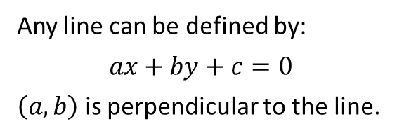
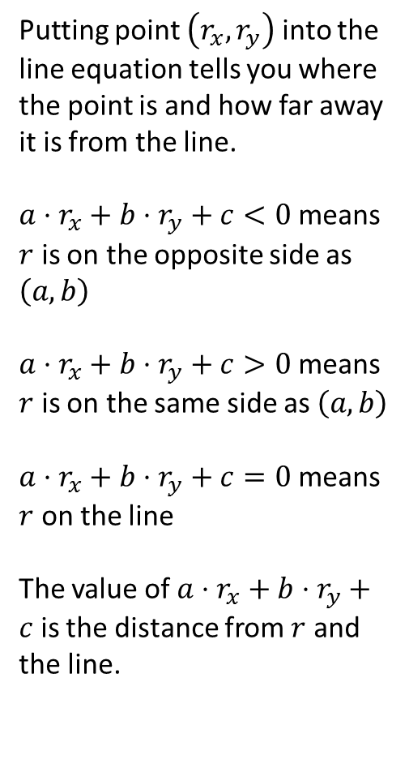
Lines
Distance from Line
Line definition
Putting point $\left(r_{x},r_{y}\right)$ into the line equation tells you where the point is and how far away it is from the line.
$a⋅r_{x}+b⋅r_{y}+c<0$ means $r$ is on the opposite side as $\left(a,b\right)$
$a⋅r_{x}+b⋅r_{y}+c>0$ means $r$ is on the same side as $\left(a,b\right)$
$a⋅r_{x}+b⋅r_{y}+c=0$ means $r$ on the line
The value of $a⋅r_{x}+b⋅r_{y}+c$ is the distance from $r$ and the line.
p
Any line can be defined by:
$$ax+by+c=0$$
$\left(a,b\right)$ is perpendicular to the line.
(a,b)
Getting a line from two points
Given $(p_{x},p_{y})$ and $(q_{x},q_{y})$, find $(a,b,c)$ for that line.
The vector $(p_{y}−q_{y},q_{x}−p_{x})$ is perpendicular to this line, leaving us with:
$$\left(p_{y}−q_{y}\right)x+\left(q_{x}−p_{x}\right)y+c=0$$
Solving for c, $c=(p_{x}⋅q_{y}−q_{x}⋅p_{y})$
[See Peter Shirley, Fundamentals of Computer Graphics]
q

Slide 15


AABB/Circle Collisions
Possibilities
2.
Calculating Collisions
$IFF (cx,cy)$ is in the AABB, then $\left(rx,ry\right)=(cx,cy)$.
Otherwise, $(rx,ry)$ is on the side or corner closest to $\left(cx,cy\right)$. Find this side/corner with a series of checks.
Four possible situations:
Circle entirely in AABB
AABB entirely in Circle
AABB corner in Circle
Circle overlaps AABB Edge
No intersection
1.
4.
Calculating Collisions
5.
3.
Checks
Find the point $\left(rx,ry\right)$ on the AABB closest to the circle center $(cx,cy)$. $IFF$ the distance is less than the radius, they are in collision.
(rx,ry)=bottom left
if(cx > rx+rw) rx=rx+rw
else if(cx > rx) rx=cx
if(cy > ry+rh) ry=ry+rh
else if(cy > ry) ry=cy

Slide 16




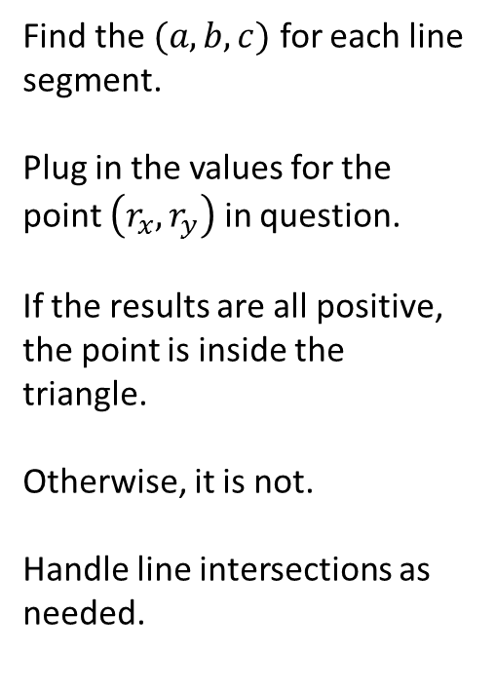
Point-Triangle Collisions
Actual Calculation
Theory
Find the $(a,b,c)$ for each line segment.
Plug in the values for the point $\left(r_{x},r_{y}\right)$ in question.
If the results are all positive, the point is inside the triangle.
Otherwise, it is not.
Handle line intersections as needed.
o
A point is inside a triangle if it is on the perpendicular side of all three lines.
$$(a_{2},b_{2})$$
q
$$(a_{1},b_{1})$$
Counterclockwise Winding
$$(a_{3},b_{3})$$
If you do not calculate the perpendicular lines in the correct order, some or all of the lines might point out of the triangle, leading to inaccurate results.
The industry standard is to go in counterclockwise order. In this case, calculating the values in the order $o,p,q$ but not $q,p,o$. This is called winding order.
p

Slide 17
 |  | First Object
 |  | Point | Circle | Axis-Aligned Rectangle (AAR) | Triangle | General Rectangle | Convex | Concave
Second Object | Circle | Distance to circle center v circle radius. | Deflate circle to point and inflate other circle. Swap to circle point. | Swap to circle AAR. | Swap to circle triangle. | Swap to circle general rectangle. | Convert to triangles. Then swap to circle triangle. | Convert to convex. Then swap to circle [shape].
 | AAR | Interior bounds check. | Deflate circle to point and inflate rectangle. Swap to ~point AAR | Left, right, top, bottom check. | Interior bounds check + same side.
 | General Rectangle | Interior bounds check. | Rotate rectangle to AAR. Swap to circle AAR. | Convert rectangle to triangles. Swap to AAR triangle. | Convert rectangle to triangles. Swap to AAR triangle.
 | Triangle | Interior bounds check. | Interior Test + Corner Test + Edge Test | Swap to triangle AAR. | Same side test
 | Convex | Interior bounds check. | Interior Test + Corner Test + Edge Test | Convert to triangles. Swap to AAR triangle. | Convert to triangles. Swap to triangle triangle.
 | Concave | Convert concave to convex. Swap to convex.

Slide 18
 |  | First Object
 |  | Point | Circle | Axis-Aligned Rectangle (AAR) | Triangle | General Rectangle | Convex | Concave
Second Object | Circle | Distance to circle center v circle radius. | Deflate circle to point and inflate other circle. Do Point/Circle. | Swap | Swap | Swap to circle general rectangle. | Convert to triangles. Then swap to circle triangle. | Convert to convex. Then swap to circle [shape].
 | AAR | Interior bounds check. | ? | Left, right, top, bottom check. | Interior bounds check + same side.
 | General Rectangle | Interior bounds check. | ? | Convert rectangle to triangles. Do AAR/Triangle. | Convert rectangle to set of triangles. Swap to AAR triangle.
 | Triangle | Interior bounds check. | Interior Test + Corner Test + Edge Test | Swap to triangle AAR. | Same side test
 | Convex | Interior bounds check. | Interior Test + Corner Test + Edge Test | Convert convex to set of triangles. Do AAR/Triangle for each. | Convert to triangles. Swap to triangle triangle.
 | Concave | Convert concave to set of convex. Collide against all new convex shapes

Slide 19
 | Two
One | - | Point | Circle | AAR | Convex | Concave
 | Point
 | Circle
 | AAR
 | Convex
 | Concave

Slide 20
 | Two
One | - | Point | Circle | AAR | Convex | Concave
 | Point | False | Distance < circle radius | Same side test | Same side test | Convert two to set of convex shapes. Do Point/Convex
 | Circle | Swap | Shrink circle one and deflate circle two. Do Point/Circle. |  | Interior Test + Corner Test + Edge Test | Convert two to set of convex shapes. Do Circle/Convex
 | AAR | Swap | Swap | Convert two to 4 points. Do Point/AAR x 4. Reverse and repeat. | Convert two to points. Do Point/AAR x n. Then do two/one Interior Test | Convert two to set of convex shapes. Do AAR/Convex
 | Convex | Swap | Swap | Swap | Convert two to points. Do Point/Convex x n. Reverse and Repeat | Convert two to set of convex shapes. Do Convex/Convex
 | Concave | Swap | Swap | Swap | Swap | Convert two to set of convex shapes. Do Convex/Concave

Slide 21

Reflections
Reflection Equation
Normal
$$r=d−2\left(d⋅n\right)n$$
r is the reflection vector
d is the velocity vector
n is the normal
Everything is normalized
Reflection Vector
Tangent Vector
World Space Velocity Vector
Velocity Vector

Slide 22
Trigonometry for Games
We use trig when we have a direction/length pair and we need to convert it to an x/y pair or vise versa.
Case 1
Case 2
We have an angle and length.
We want x and y.
x = Math.cos(angle)*length;
y = Math.sin(angle)*length;
We have x and y.
We want an angle and length.
angle = Math.atan2(y,x);
length = Math.sqrt(x*x + y*y);
Y
Length
Angle
X

Slide 23
Rendering Problems
Simplest rendering pipeline.
Code
Pixel Buffer
Screen
Problem: Screen Tearing
Problem: Pixel Buffer Dependence
If you write to the pixel buffer while the screen is reading from the screen buffer, the user sees parts of two frames.
Solution: Double-buffering
If you write directly to the pixel buffer, you cannot do post processing or do split screen.
Solution: Deferred rendering

Slide 24
Double Buffering
Don’t write where the screen is reading.
Code
Pixel Buffer(s)
Screen
Double Buffering
In JavaScript
Write to the “back” buffer while the screen reads from the “front” buffer. When you are done writing, tell the system it can swap the buffers. Some GPUs extend this to triple buffering.
Instead using a timer to write to the canvas, use window. requestAnimationFrame(). This lets you know when it is safe to write to the canvas without screen tearing.

Slide 25
Deferred Rendering
Don’t write to the pixel buffers at all.
Code
Temporary Buffer
Pixel Buffer(s)
Screen
Write to a temporary image
In JavaScript
Create a temporary buffer. Then write to the context of that buffer. You can then do post processing on that buffer (color adjustment, etc.) or place it at a specific place on the screen for a split screen game or minimap.
Create a new canvas object using document.createElement('canvas’);
Get the context of this new object and draw to that context. Then use drawImage() with a reference to that canvas instead of a reference to an image.

